Slide 1

Church Financial recordkeeping
by : FixIt.

Slide 2
Overview
Introduction
Requirement of the application
Team organization
Design, Implementation, Test Report
Section 1
Problem encountered
Deviations
Problem remaining
Section 2
Future Work
Different ?
Functionality, Users, Deployment issues
Learned
References

Slide 3
Introduction
It is a financial recordkeeping application.
Our project is to maintain donation records made to a Church.
This is to replace the existing system, with robust features to support the needs of secretary.
This application allows the user to enter the funds and also print reports, in customized date format.

Slide 4
Purpose of the Application
Previous application -> Proposed Requirements -> Developed Requirements
It allows to add, delete the members at any time.
It allows to add, delete type of funds donated to church at any time.
The customized reports can be generated for different period of time.
It is user friendly application.
We tried to develop a bug free application.

Slide 5

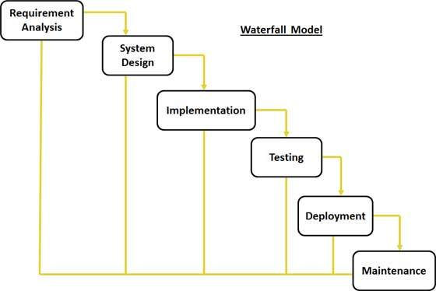



Team Organization
The team (FIXIT) is utilized a controlled decentralized structure.
Process Model : Water Fall Model.

Slide 6
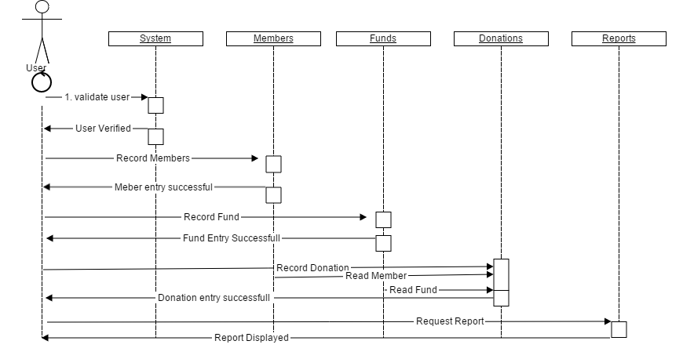
Design Diagram :Sequence Diagram

Slide 7
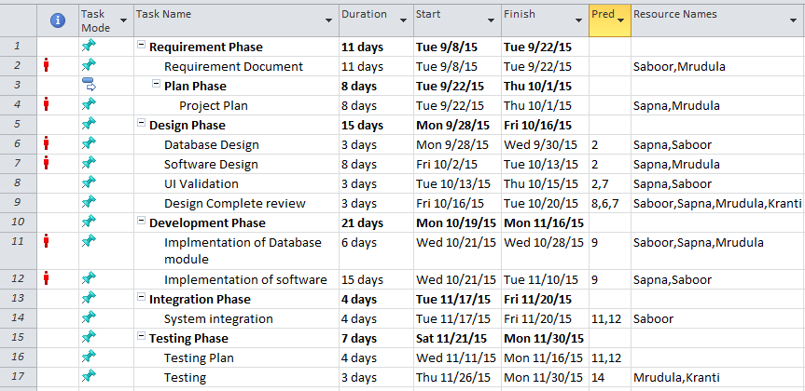
Task list
The following table shows the list of tasks identified in the project and executed.

Slide 8
Practical Implementation
Language ASP.Net, SQL Queries.
Demo at the end…

Slide 9
Test Report
The application has been tested from the implementation stages of the development
All the team members were involved in testing.
Acceptance testing was performed after finalizing the requirements.
Test cases are identified and executed.
Every functionality was implemented and tested for correctness.
All the functionalities implemented are integrated and tested.
The whole system is tested for usability of the application.

Slide 10
Problems observed
Functional Issues
To populate and display the details in table(grid view).
To generate the report for print purpose(PDF).
To read the values from the combo box after editing.
Redirecting to page after updating the data.
Non-Functional Issues
Scalability: Unavailability of hardware(Server) for project deployment.
Lack of requirements clarity and understandability.
Performance – for example response time, throughput, static volumetric.
Application can be improved using HTML5 and other languages like php, javascript.
Time problems with the team meeting and follow ups.
Time spent in Documenting.
Serviceability.

Slide 11
Problems in the system
Duplicate entries.
Design issues : Focus on the fields.
Report design issues.

Slide 12
Future Works
To make project accessible to many users by deploying the application on the server.
The automated Email sending option can be implemented, to send emails that contain reports to the members on yearly basis.
To be able to generate different reports like funds.
To resolve browser issues like back button navigation, account session problems, default special character usage avoidance.
To make application more browser supportive to utilize the good interface and functionalities.

Slide 13
Different Work
To develop project as a website and make accessible to many Church users .
The automated Email sending notifications.
Generate reports.
Online payment options.

Slide 14
Functionalities
The major functionalities of the proposed software are:
Login Page
Insert(Member, Fund, Donation )
Update(Member, Fund, Donation )
Delete(Member, Fund, Donation )
Search(Member, Fund, Donation )
Print Reports

Slide 15
Client/Customer/User
The Church financial application is used by the church secretary.
Secretary uses the application to keep records of all the donations, and generate reports.
Prof. Cerise Wuthrich is the client, customer and user for our project.

Slide 16
Deployment issues
As the application was developed in ASP. Net framework the server system on to which it is to be deployed must also have ASP. Net framework.
The target system should have a version Microsoft Visual Studio same as or later versions of the developed system and Sql Server 2012 for application to run.
The system must have latest or up to date version of Acrobat reader for the reports.

Slide 17
Learned
Successfully developed the application.
Learned new areas of software development.
Learned new languages and development environment like ASP.NET, C#, javascript, SQL Queries.
Team meeting co-ordination, cooperation.

Slide 18
References
McGraw, R. J. (2015, june 15). FOXMIS. Retrieved october 27, 2015,Google:http://community.mis.temple.edu/mis2101sec711summer2015/
Larman, C., Applying UML and Patterns: Introduction to Object-Oriented Analysis and Design and Iterative Development, 3rdedition (October 2004).
Sommerville, I., Software Engineering 9th edition book, Pearson (March 2004).

Slide 19
Queries…??

Slide 20
Thank you… ☺ ☺ ☺ ☺

